Slide 1

CSE 3521: Introduction to Artificial Intelligence
[Many slides are adapted from the UC Berkeley. CS188 Intro to AI at UC Berkeley and previous CSE 3521 course at OSU.]

Slide 2
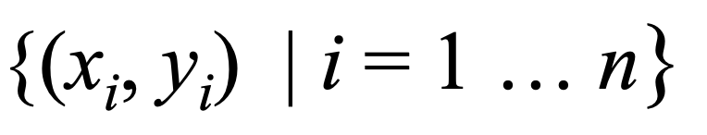
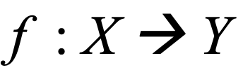
Supervised Learning: find f
Given: Training set
Find: A good approximation to
Examples: what are X, Y?
Spam Detection
Map email to {Spam, NotSpam}
Digit recognition
Map pixels to {0,1,2,3,4,5,6,7,8,9}
Stock Prediction
Map new, historic prices, etc. to ℜ (the real numbers)

Slide 3
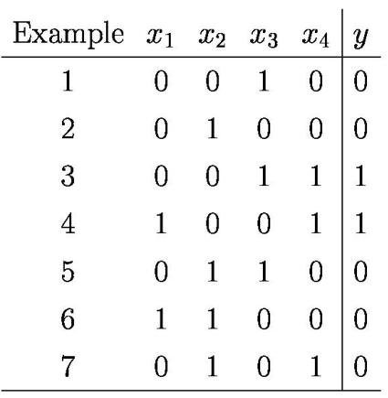
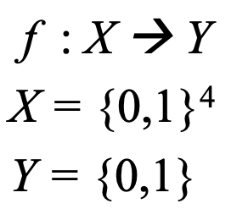
A Supervised Learning Problem
Consider a simple Boolean dataset:
Question 1:
How should we pick the hypothesis space, the set of possible functions f ?
Question 2:
How do we find the best f in the hypothesis space?

Slide 4
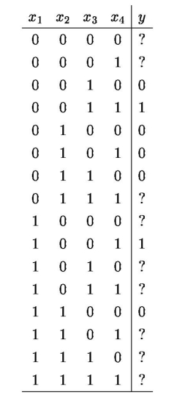
Most General Hypothesis Space
Consider all possible Boolean functions over four input features!
2¹⁶ possible hypotheses
2⁹ are consistent with our dataset
How do we choose the best one?

Slide 5
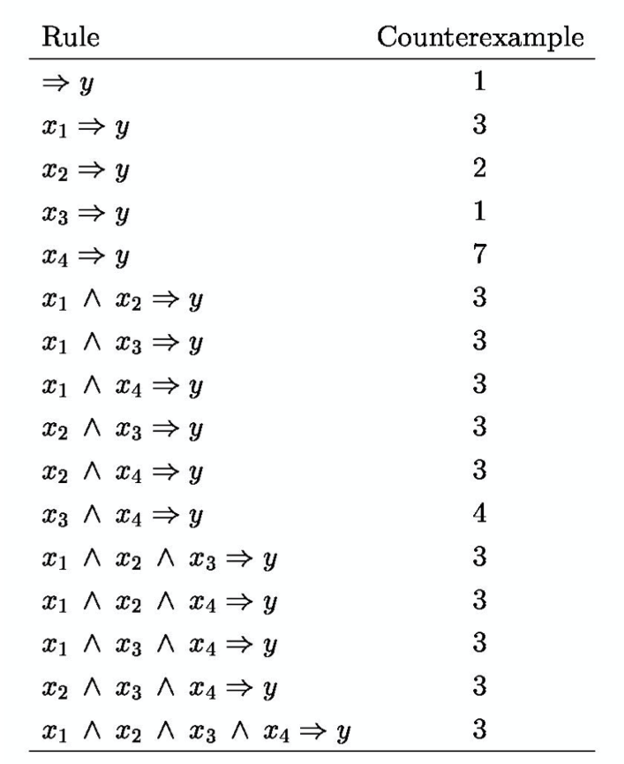
A Restricted Hypothesis Space
Consider all conjunctive Boolean functions.
16 possible hypotheses
None are consistent with our dataset
How do we choose the best one?

Slide 6
Simple Training Dataset
Day | Outlook | Temperature | Humidity | Wind | PlayGolf?
D1 | Sunny | Hot | High | Weak | No
D2 | Sunny | Hot | High | Strong | No
D3 | Overcast | Hot | High | Weak | Yes
D4 | Rain | Mild | High | Weak | Yes
D5 | Rain | Cool | Normal | Weak | Yes
D6 | Rain | Cool | Normal | Strong | No
D7 | Overcast | Cool | Normal | Strong | Yes
D8 | Sunny | Mild | High | Weak | No
D9 | Sunny | Cool | Normal | Weak | Yes
D10 | Rain | Mild | Normal | Weak | Yes
D11 | Sunny | Mild | Normal | Strong | Yes
D12 | Overcast | Mild | High | Strong | Yes
D13 | Overcast | Hot | Normal | Weak | Yes
D14 | Rain | Mild | High | Strong | No

Slide 7
A Decision Tree for f: <Outlook, Temperature, Humidity, Wind> → PlayGolf
Outlook
Sunny
Overcast
Rain
Humidity
Yes
Wind
High
Normal
Strong
Weak
No
Yes
No
Yes
Each internal node: test one discreet valued attribute X_{i}
Each branch from a node: selects one value for X_{i}
Each leaf node: predict Y

Slide 8
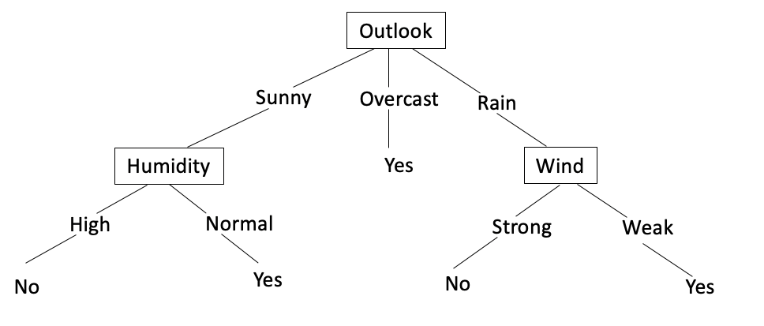
Decision Tree Learning
Problem Setting
Set of possible instances X
Each instance x in X is a feature vector
e.g. <Humidity = Low; Wind = Weak; Outlook = Rain; Temperature = Hot>
Unknow target function f: X → Y
Y = 1 if we play Golf on this day; else Y = 0
Set of function hypotheses H = {h| h : X → Y}
Each hypotheses h is a decision tree
Trees sort x to leaf, which assigns y
Input:
Training examples {<x^{(i)}, y^{(i)}>} of unknown target function f
Output
Hypothesis h ∈ H that best approximates target function f

Slide 9
Decision Tree Learning
Problem Setting
Set of possible instances X
Each instance x in X is a feature vector
e.g. <Humidity = Low; Wind = Weak; Outlook = Rain; Temperature = Hot>
Unknow target function f: X → Y
Y = 1 if we play Golf on this day; else Y = 0
Set of function hypotheses H = {h| h : X → Y}
Each hypotheses h is a decision tree
Trees sort x to leaf, which assigns y
Input:
Training examples {<x^{(i)}, y^{(i)}>} of unknown target function f
Output
Hypothesis h ∈ H that best approximates target function f

Slide 10
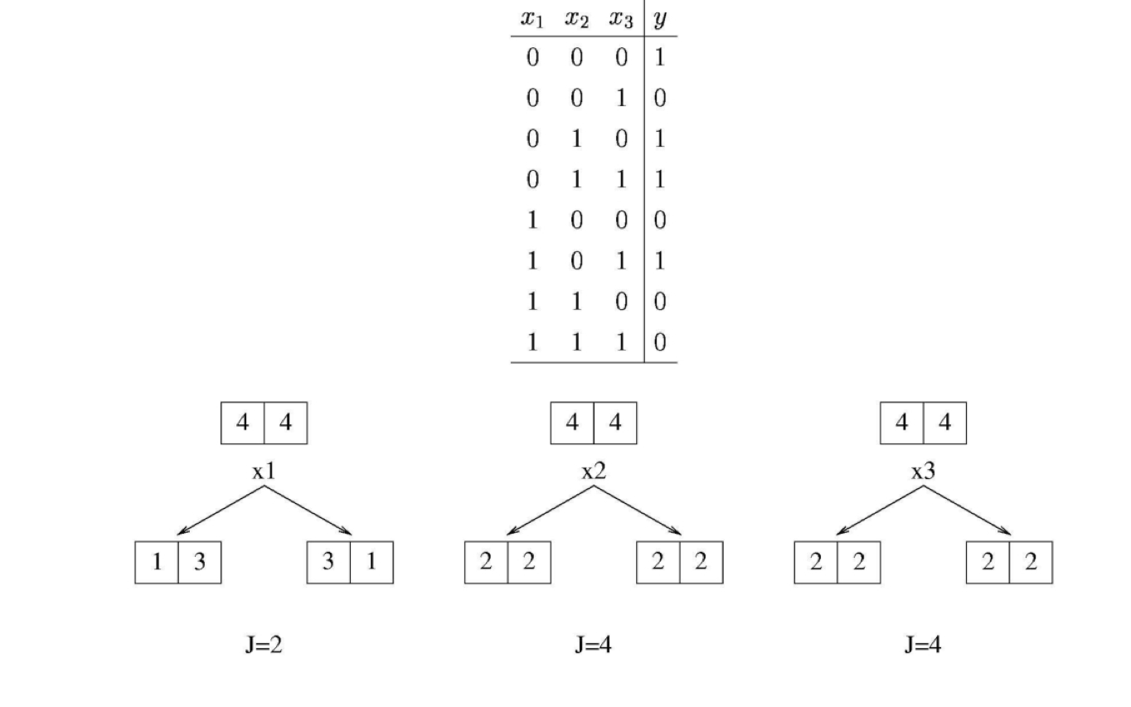
Example of Choosing the Best Attribute

Slide 11
Example of Choosing the Best Attribute

Slide 12
Example of Choosing the Best Attribute

Slide 13
Example of Choosing the Best Attribute

Slide 14
Example of Choosing the Best Attribute

Slide 15
Example of Choosing the Best Attribute

Slide 16
Choosing the Best Attribute
Unfortunately this measure does not always work well
As it does not detect cases where we are making progress toward a good tree

Slide 17
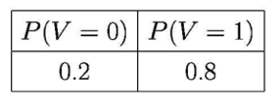
Better Heuristic from Information Theory
Let V be a random variable with the following probability distribution
The surprise S(V=v) of each value of V is defined to be
S(V= v) = - log P(V =v)
An event with probability 1 gives zeo surprise
An event with probability 0 gives infinite surprise
Surprise equals Number of bits of information that needed to be transmitted to a recipient who knows the probabilities of the results
This is also called the description length of V = v
Fractional bits only make sense if they are part of longer message
e.g. describe a whole sequence of coin toss

Slide 18
Entropy
The Entropy of V, denoted by Entropy(V) is defined as below:
Here V is a binary variable with only possible values 0 and 1
Entropy can be viewed as a measure of uncertainty

Slide 19
Dataset

Slide 20
Step 1: Determine the Decision Column
Since decision trees are used for clarification, you need to determine the classes which are the basis for the decision.
In this case, it it the last column, that is Play Golf column with classes Yes and No.
Next determine the rootNode we need to compute the entropy.
To compute the entropy, we create a frequency table for the classes

Slide 21
Step 1: Determine the Decision Column
Since decision trees are used for clarification, you need to determine the classes which are the basis for the decision.
In this case, it it the last column, that is Play Golf column with classes Yes and No.
Next determine the rootNode
we need to compute the entropy.
To compute the entropy, we create a frequency table for the classes

Slide 22
Step 1: Determine the Decision Column
Since decision trees are used for clarification, you need to determine the classes which are the basis for the decision.
In this case, it it the last column, that is Play Golf column with classes Yes and No.
Next determine the rootNode
we need to compute the entropy.
To compute the entropy, we create a frequency table for the classes

Slide 23
Step 1: Determine the Decision Column

Slide 24
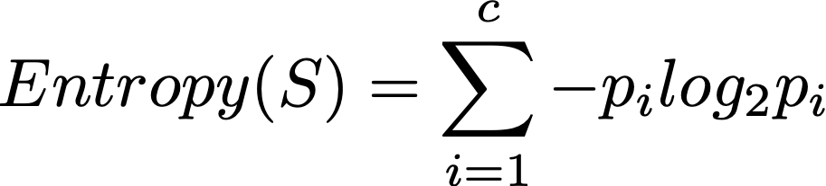
Step 2: Calculating Entropy for the classes (Play Golf)
In this step, you need to calculate the entropy for the Decision Column (Play Golf)
Entropy(PlayGolf) = E(5-,9+)

Slide 25
Step 2: Calculating Entropy for the classes (Play Golf)
In this step, you need to calculate the entropy for the Decision Column (Play Golf)
Entropy(PlayGolf) = E(5-,9+)

Slide 26
Step 2: Calculating Entropy for the classes (Play Golf)
In this step, you need to calculate the entropy for the Decision Column (Play Golf)
Entropy(PlayGolf) = E(5-,9+)

Slide 27
Step 2: Calculating Entropy for the classes (Play Golf)
In this step, you need to calculate the entropy for the Decision Column (Play Golf)
Entropy(PlayGolf) = E(5-,9+)

Slide 28
Step 3: Calculate Entropy for Other Attributes After Split
For the other four attributes, we need to calculate the entropy after each of the split.
E(PlayGolf, Outlook)
E(PlayGolf, Temperature)
E(PlayGolf, Humidity)
E(PlayGolf,Windy)
The entropy for two variables is calculated using the formula.
The easiest way to approach this calculation is to create a frequency table for the two variables

Slide 29
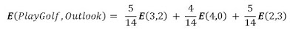
Step 3: Calculate Entropy for Other Attributes After Split
E(PlayGolf, Outlook) Calculation:
To calculate E(PlayGolf, Outlook), we would use the formula below:
E(PlayGolf, Outlook) = P(Sunny) E(3,2) + P(Overcast) E(4,0) + P(rainy) E(2,3)

Slide 30
Step 3: Calculate Entropy for Other Attributes After Split
E(PlayGolf, Outlook) Calculation:

Slide 31
Step 3: Calculate Entropy for Other Attributes After Split
E(PlayGolf, Outlook) Calculation:

Slide 32
Step 3: Calculate Entropy for Other Attributes After Split
E(PlayGolf, Outlook) Calculation:

Slide 33
Step 3: Calculate Entropy for Other Attributes After Split
E(PlayGolf, Outlook) Calculation:
E(4,0) = 0;
E(2,3) = E(3,2)

Slide 34
Step 3: Calculate Entropy for Other Attributes After Split
E(PlayGolf, Outlook) Calculation:
E(PlayGolf, Outlook) = P(Sunny) E(3,2) + P(Overcast) E(4,0) + P(rainy) E(2,3)

Slide 35
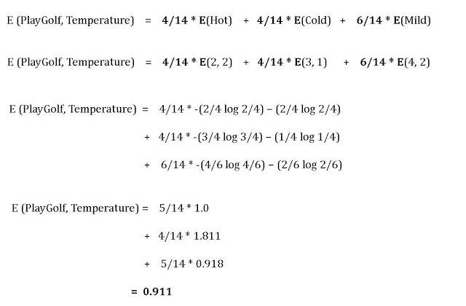
Step 3: Calculate Entropy for Other Attributes After Split
E(PlayGolf, Temperature) Calculation
E(PlayGolf, Temperature) = P(Hot) E(2,2) + P(Cold) E(3,1) + P(Mild) E(4,2)

Slide 36
Step 3: Calculate Entropy for Other Attributes After Split
E(PlayGolf, Humidity) Calculation
E(3,4)
E(6,1)

Slide 37
Step 3: Calculate Entropy for Other Attributes After Split
E(PlayGolf, Windy) Calculation

Slide 38
Step 3: Calculate Entropy for Other Attributes After Split
E(PlayGolf, Outlook) = 0.693
E(PlayGolf, Temperature) = 0.911
E(PlayGolf, Humidity) = 0.788
E(PlayGolf,Windy) = 0.892

Slide 39
Step 4: Calculating Information Gain for Each Split
The next step is to calculate the information gain for each of the attributes.
The information gain is calculated from the split using each of the attributes.
Then the attribute with the largest information gain is used for the split.
The information gain is calculated using the formula: Gain(S,T) = Entropy(S) – Entropy(S,T)

Slide 40
Step 4: Calculating Information Gain for Each Split
Gain(PlayGolf, Outlook) = Entropy(PlayGolf) – Entropy(PlayGolf, Outlook)
= 0.94 – 0.693 = 0.247
Gain(PlayGolf, Temperature) = Entropy(PlayGolf) – Entropy(PlayGolf, Temperature)
= 0.94 – 0.911 = 0.029
Gain(PlayGolf, Humidity) = Entropy(PlayGolf) – Entropy(PlayGolf, Humidity)
= 0.94 – 0.788 = 0.152
Gain(PlayGolf, Windy) = Entropy(PlayGolf) – Entropy(PlayGolf, Windy)
= 0.94 – 0.892 = 0.048

Slide 41
Step 4: Calculating Information Gain for Each Split
Gain(PlayGolf, Outlook) = Entropy(PlayGolf) – Entropy(PlayGolf, Outlook)
= 0.94 – 0.693 = 0.247
Gain(PlayGolf, Temperature) = Entropy(PlayGolf) – Entropy(PlayGolf, Temperature)
= 0.94 – 0.911 = 0.029
Gain(PlayGolf, Humidity) = Entropy(PlayGolf) – Entropy(PlayGolf, Humidity)
= 0.94 – 0.788 = 0.152
Gain(PlayGolf, Windy) = Entropy(PlayGolf) – Entropy(PlayGolf, Windy)
= 0.94 – 0.892 = 0.048

Slide 42
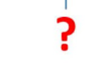
Step 5: Perform the 1st split
From our calculation, the highest information gain comes from Outlook. Therefore the split will look like this:

Slide 43
Step 5: Perform the 1st split
Overcast outlook requires no further split because it is just one homogeneous group.
So we have a leaf node.

Slide 44
Step 5: Perform the 1st split
From our calculation, the highest information gain comes from Outlook. Therefore the split will look like this:
Overcast outlook requires no further split because it is just one homogeneous group.
So we have a leaf node.

Slide 45
Step 6: Perform further splits
The Sunny and the Rainy attributes needs to be split
The Rainy outlook can be split using either Temperature, Humidity or Windy.
Question: What attribute would best be used for this split?
Gain(PlayGolf, Outlook=Rainy, Temperature) = Entropy(PlayGolf, Outlook=Rainy) – Entropy(PlayGolf, Outlook=Rainy, Temperature)
Gain(PlayGolf, Outlook=Rainy, Humidity) = Entropy(PlayGolf, Outlook=Rainy) – Entropy(PlayGolf, Outlook=Rainy, Humidity)
Gain(PlayGolf, Outlook=Rainy, Windy) = Entropy(PlayGolf, Outlook=Rainy) – Entropy(PlayGolf, Outlook=Rainy, Windy)

Slide 46
Step 6: Perform further splits
The Sunny and the Rainy attributes needs to be split
The Rainy outlook can be split using either Temperature, Humidity or Windy.
Question: What attribute would best be used for this split?
Humidity, produces homogenous groups.
Gain(PlayGolf, Outlook=Rainy, Humidity) = Entropy(PlayGolf, Outlook=Rainy) – Entropy(PlayGolf, Outlook=Rainy, Humidity)= Entropy(PlayGolf, Outlook=Rainy) – 0

Slide 47
Step 6: Perform further splits

Slide 48
Step 6: Perform further splits
The Rainy outlook can be split using either Temperature, Humidity or Windy.
Question: What attribute would best be used for this split? Why?
Answer: Windy . Because it produces homogeneous groups.

Slide 49
Step 6: Perform further splits
The Rainy outlook can be split using either Temperature, Humidity or Windy.
Question: What attribute would best be used for this split? Why?
Answer: Windy . Because it produces homogeneous groups.

Slide 50
ID3 Algorithm
ID3 (S, A, V)
Let:
S = Learning Set A = Attibute Set V = Attribute Values
Begin Load learning sets and create decision tree root node(rootNode), Add learning set S into root not as its subset
For rootNode, compute Entropy(rootNode.subset)
If Entropy(rootNode.subset) == 0 (subset is homogeneous) return a leaf node If Entropy(rootNode.subset)!= 0 (subset is not homogeneous) compute Information Gain for each attribute left (not been used for spliting) Find attibute A with Maximum(Gain(S, A)) Create child nodes for this root node and add to rootNode in the decision tree For each child of the rootNode Apply ID3(S, A, V) Continue until a node with Entropy of 0 or a leaf node is reached End

Slide 51
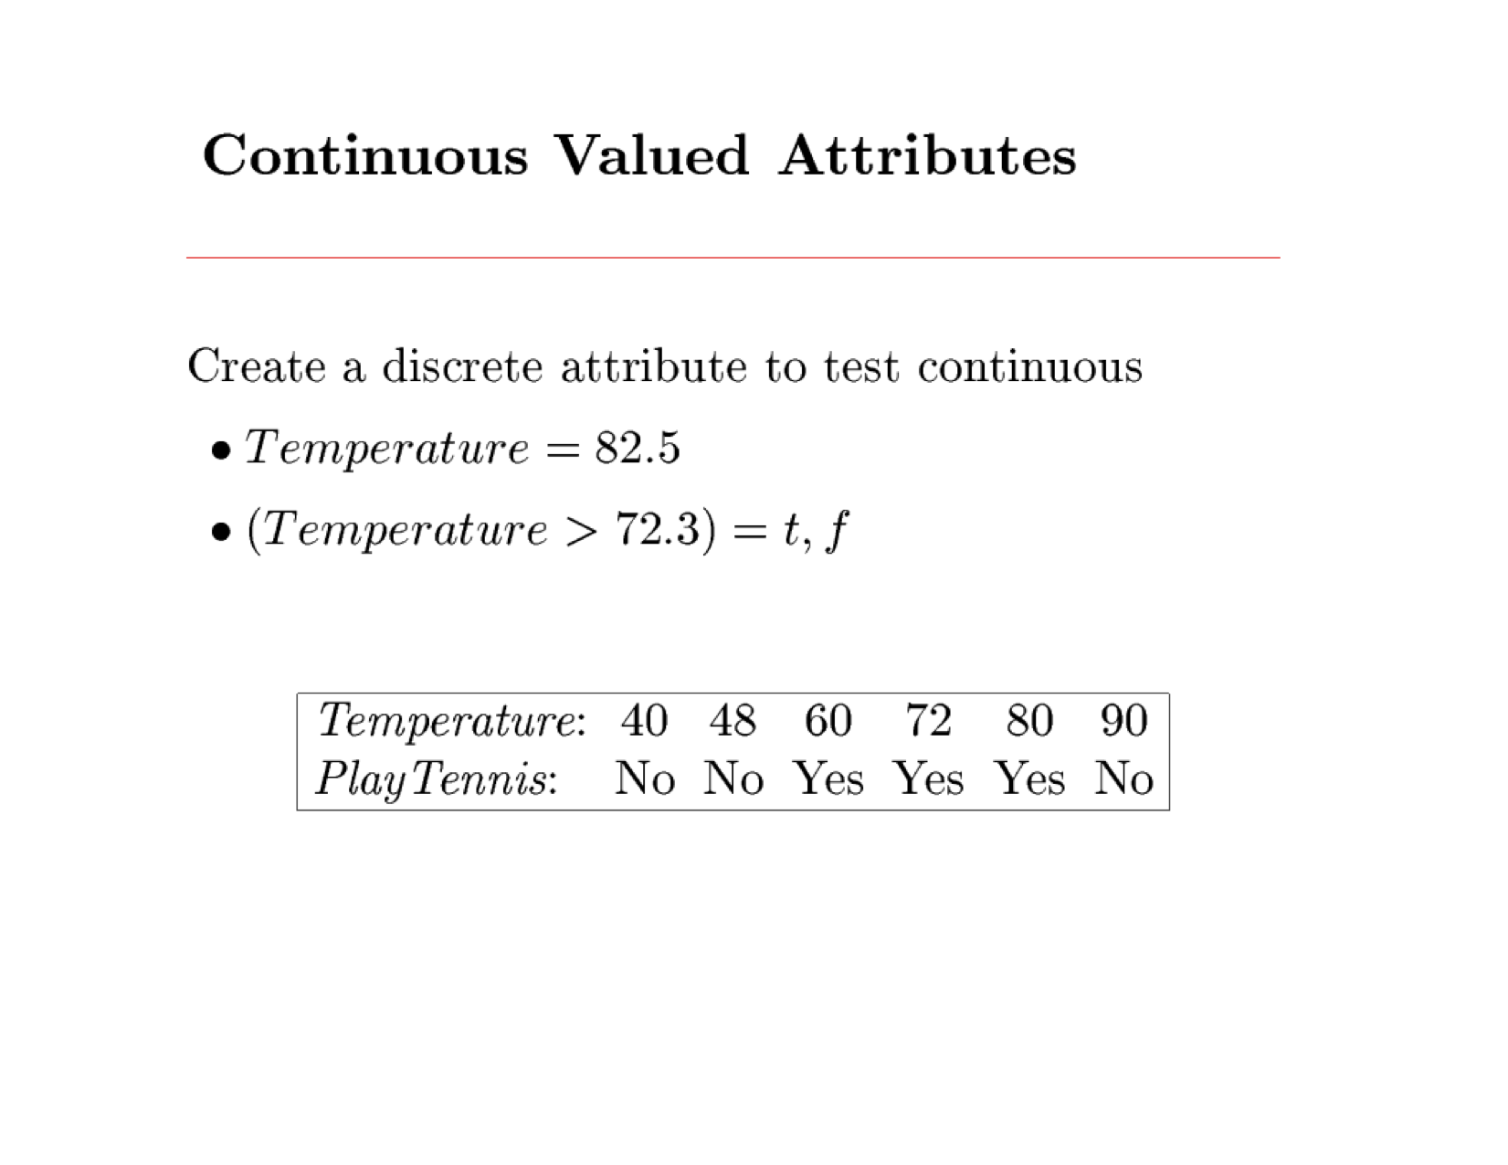
Continuous Valued Attribute
Play Golf:

Slide 52
Unknown Attribute
Unknown Attribute

Slide 53
Unknown Attribute
Unknown Attribute

Slide 54
Unknown Attribute
Unknown Attribute
#High=5
#Normal = 7

Slide 55
Unknown Attribute
Unknown Attribute
Normal
#High=5
#Normal = 7

Slide 56
Unknown Attribute
Unknown Attribute
For PlayGlolf=No
#High=3
#Normal = 1

Slide 57
Unknown Attribute
Unknown Attribute
High
For PlayGlolf=No
#High=3
#Normal = 1

Slide 58
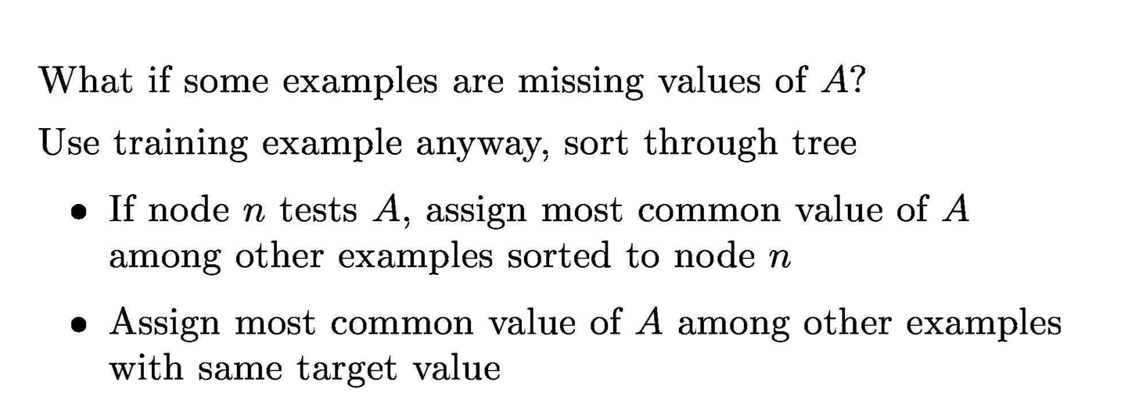
Unknown Attribute Values

